Slide 1
Image Captioning
Ansh Goyal17BCE1278
Harshil Gupta 17BCE1112
Shekhar Gaur 17BCE1183

Slide 2
Introduction
Image Captioning is the process of generating textual description of an image. It uses both Natural Language Processing and Computer Vision to generate the captions. Deep Learning is a very rampant field right now – with so many applications coming out day by day. And the best way to get deeper into Deep Learning is to get hands-on with it.. We will take a look at an interesting multi modal topic where we will combine both image and text processing to build a useful Deep Learning application, aka Image Captioning. Image Captioning refers to the process of generating textual description from an image – based on the objects and actions in the image.

Slide 3
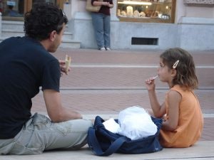
What does an Image Captioning Problem entail?
Suppose you see this picture –
What is the first thing that comes to you mind? Here are a few sentences that people could come up with : A man and a girl sit on the ground and eat . A man and a little girl are sitting on a sidewalk near a blue bag eating . A man wearing a black shirt and a little girl wearing an orange dress share a treat . A quick glance is sufficient for you to understand and describe what is happening in the picture. Automatically generating this textual description from an artificial system is the task of image captioning. The task is straightforward – the generated output is expected to describe in a single sentence what is shown in the image – the objects present, their properties, the actions being performed and the interaction between the objects, etc. But to replicate this behaviour in an artificial system is a huge task, as with any other image processing problem and hence the use of complex and advanced techniques such as Deep Learning to solve the task.

Slide 4
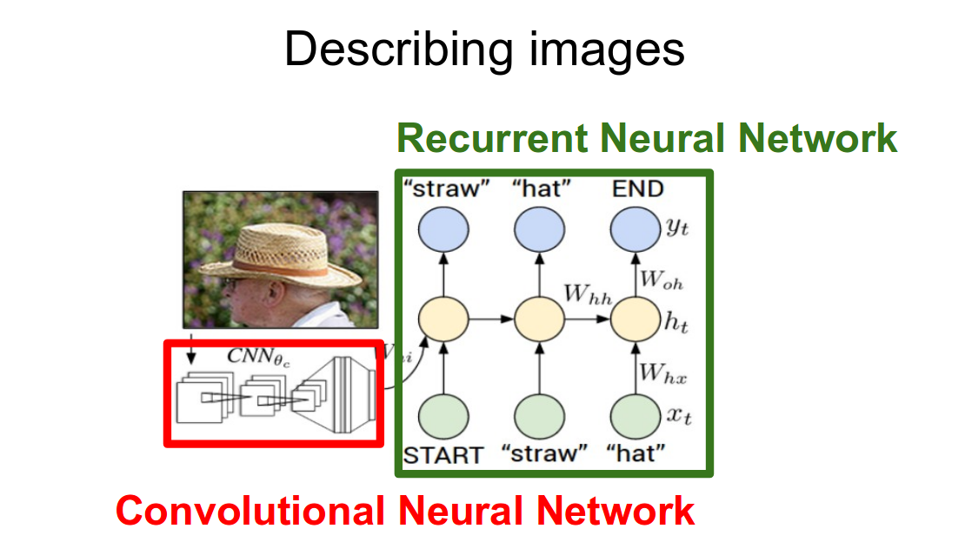
Methodology to Solve the Task
The task of image captioning can be divided into two modules logically – one is an image based model – which extracts the features and nuances out of our image, and the other is a language based model – which translates the features and objects given by our image based model to a natural sentence.
For our image based model (viz encoder) – we usually rely on a Convolutional Neural Network model. And for our language based model (viz decoder) – we rely on a Recurrent Neural Network. The image below summarizes the approach given above.

Slide 5
Usually, a pretrained CNN extracts the features from our input image. The feature vector is linearly transformed to have the same dimension as the input dimension of the RNN/LSTM network. This network is trained as a language model on our feature vector.
For training our LSTM model, we predefine our label and target text. For example, if the caption is “A man and a girl sit on the ground and eat.”, our label and target would be as follows –
Label – [ <start>, A, man, and, a, girl, sit, on, the, ground, and, eat, . ] Target – [ A, man, and, a, girl, sit, on, the, ground, and, eat, ., <end> ]
This is done so that our model understands the start and end of our labelled sequence.

Slide 6
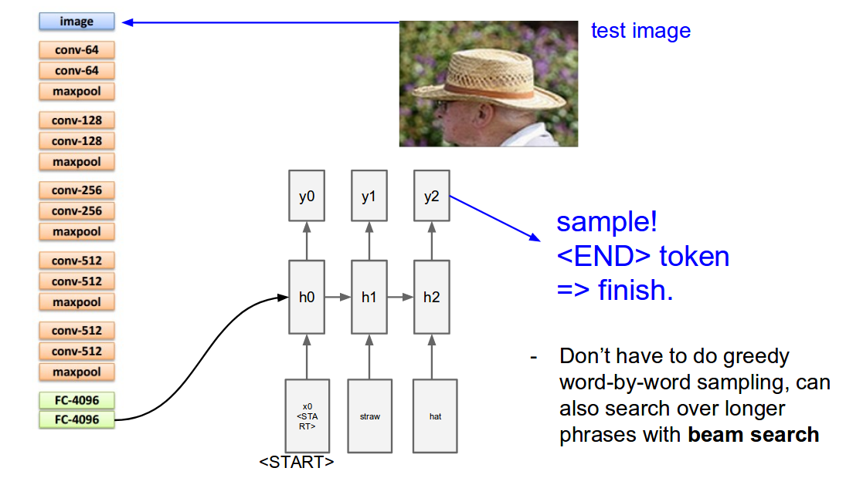

Slide 7
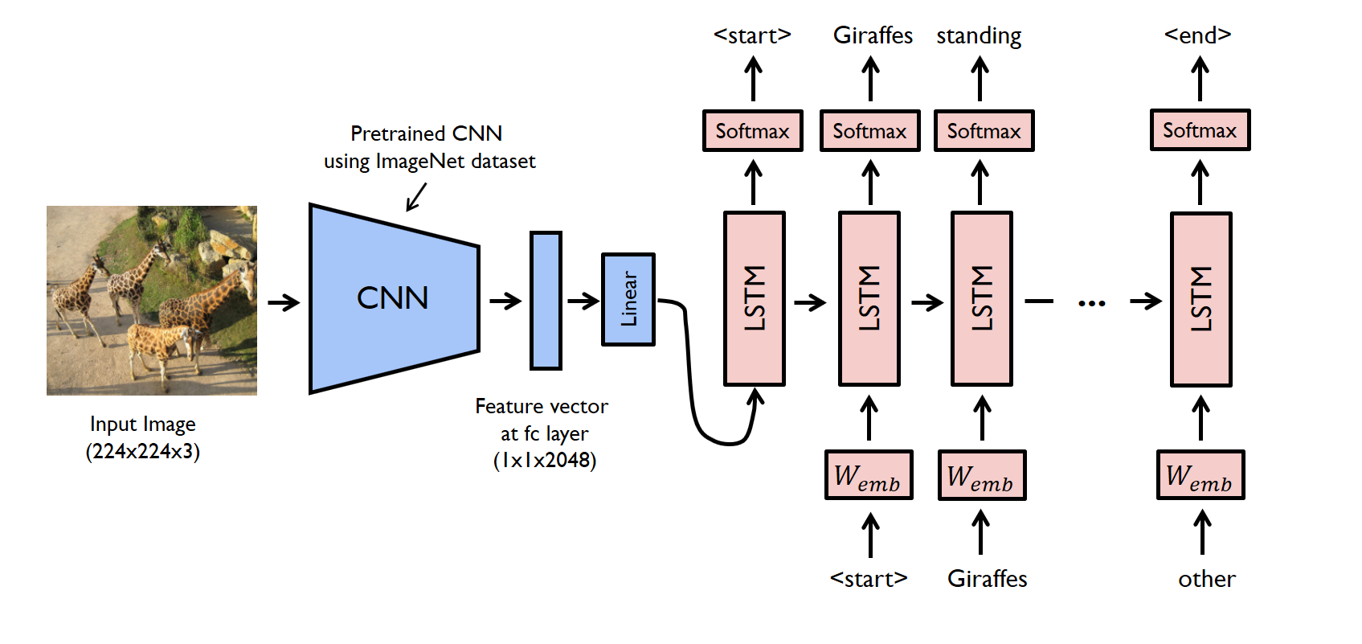
Walkthrough of Implementation
Let’s look at a simple implementation of image captioning in Pytorch. We will take an image as input, and predict its description using a Deep Learning model.
In this walkthrough, a pre-trained model is used as an encoder, and the decoder is an LSTM network.

Slide 8
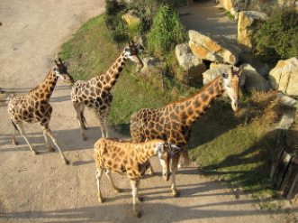
EXAMPLE
Caption:A group of giraffes standing in a grassy area .

